Slide 1
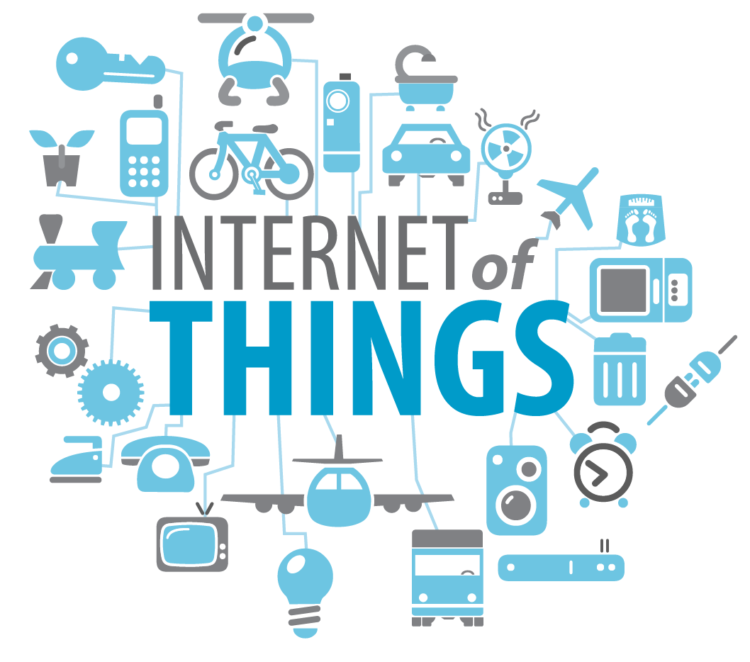
AKANKSHA PRASAD

Slide 2
What Exactly is it?

Slide 3
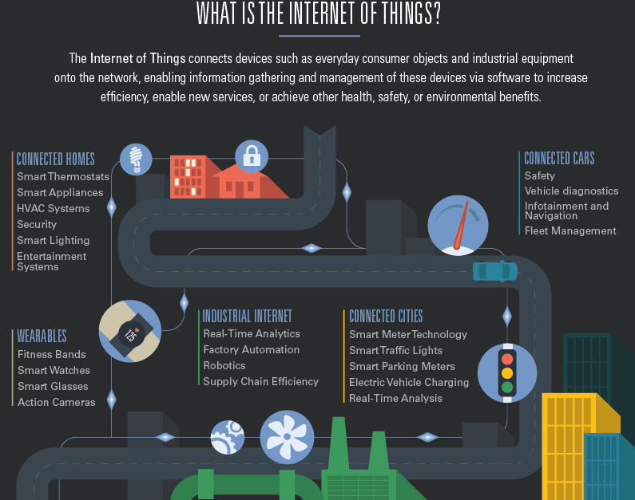
It is the next stage of internet when “things” are connected to web /network
The Internet of Things (IoT) is a scenario in which objects, animals or people are provided with unique identifiers(IP address) and has the ability to transfer data over a network without requiring human-to-human or human-to-computer interaction. IoT has evolved from the convergence of wireless technologies, micro-electromechanical systems (MEMS) and the Internet.
The ITU has described four dimensions in IoT: item identification (“tagging things”), sensors and wireless sensor networks (“feeling things”), embedded systems (“thinking things”) and nano-technology (“shrinking things”)
Notes:
Micro-electromechanical systems (MEMS) is a technology that combines computers with tiny mechanical devices such as sensors, valves, gears, mirrors, and actuators embedded in semiconductor chips

Slide 4
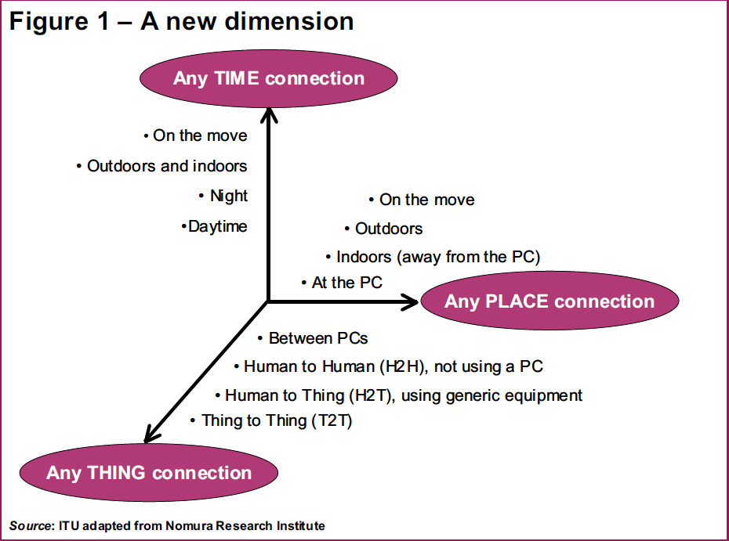
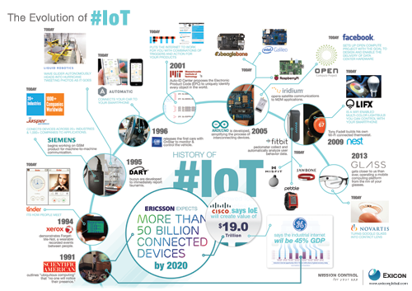
History
internet of computers
1969
Internet of peoples
1979
Internet of things
1999
Notes:
1999 - A big year for the IoT and MIT kevin ashton p&g supply cahin using rfid before that Carnegie melon in early 1980’s coke vending machine

Slide 5
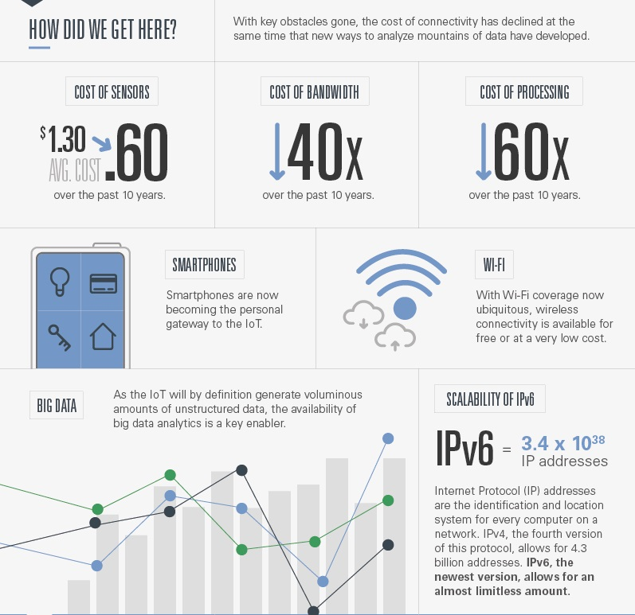
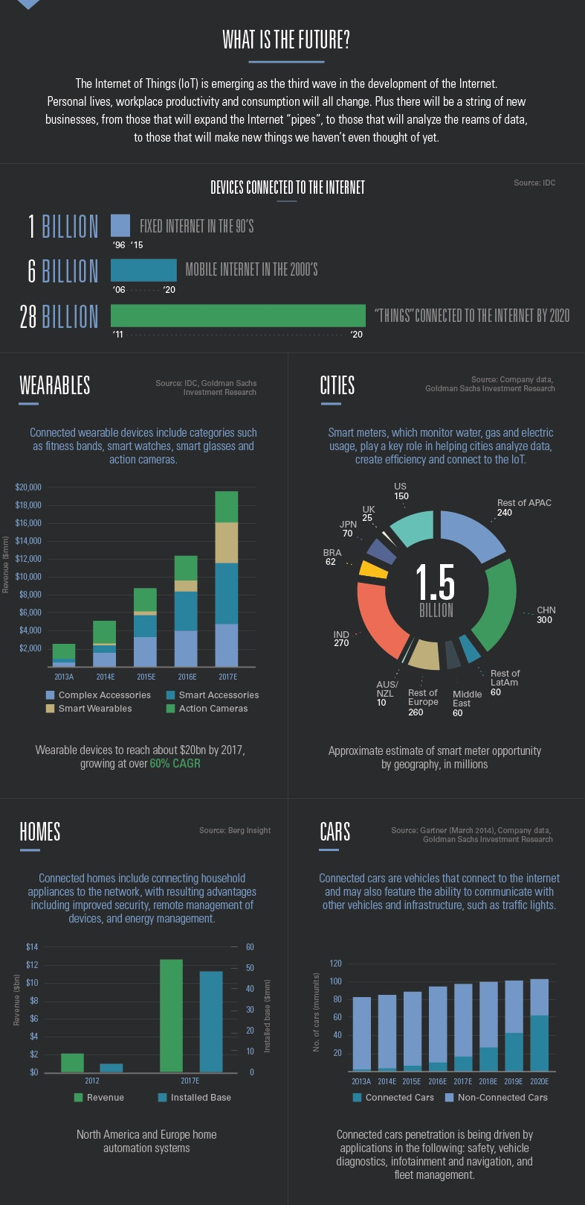
Trends

Slide 6
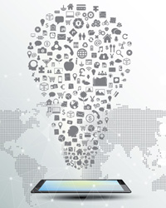
Technology used
Connectivity and networking
Protocols
Software
Hardware
Cloud and machine learning

Slide 7
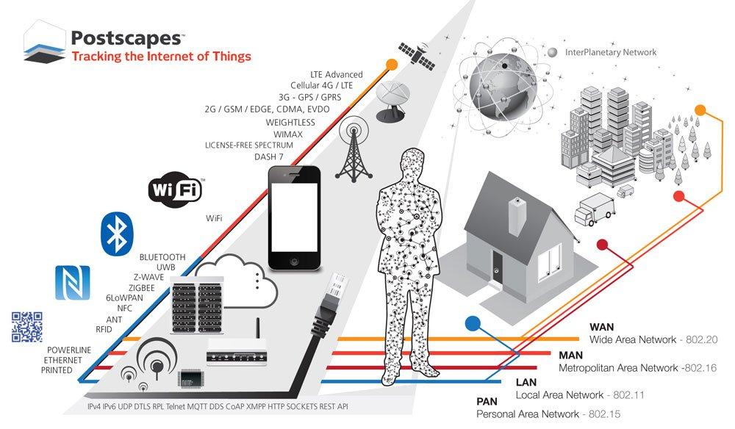
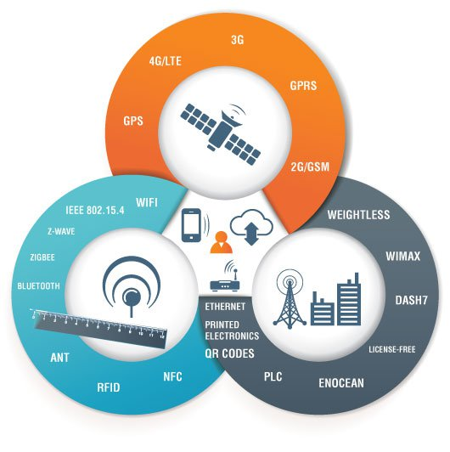
Connectivity and networking

Slide 8
Protocols
Constrained Application Protocol (CoAP) is a software protocol intended to be used in very simple electronics devices that allows them to communicate interactively over the Internet. It is particularly targeted for small low power sensors, switches, valves and similar components that need to be controlled or supervised remotely, through standard Internet networks.
WebSocket standard simplifies much of the complexity around bi-directional web communication and connection management.
IPv6 is an Internet Layer protocol for packet-switched internetworking and provides end-to-end datagram transmission across multiple IP networks.
6LoWPAN is a acronym of IPv6 over Low power Wireless Personal Area Networks. It is an adaption layer for IPv6 over IEEE802.15.4 links. This protocol operates only in the 2.4 GHz frequency range with 250 kbps transfer rate.

Slide 9




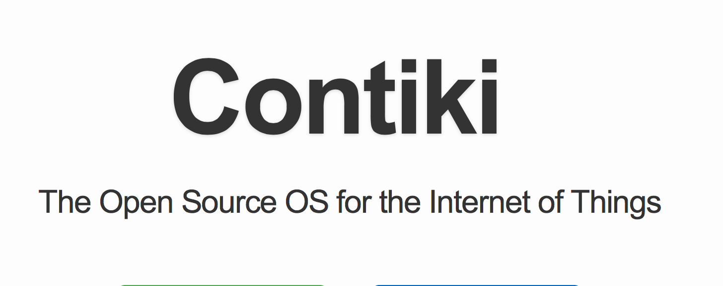
Software
Thingsquare Mist open source firmware is exceptionally lightweight, battle-proven, and works with multiple microcontrollers with a range of radios
Contiki, Nodered, Thingspeak through which MATLAB can be used for data handling, Riot OS etc.
All these provide software to log sensor generated data and to integrate sensors on gateway devices

Slide 10
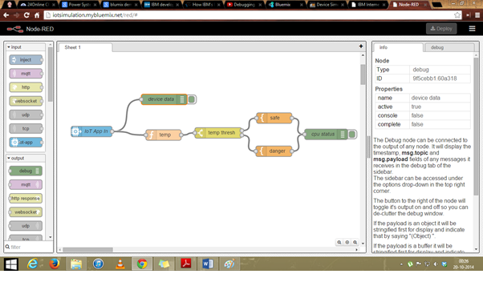
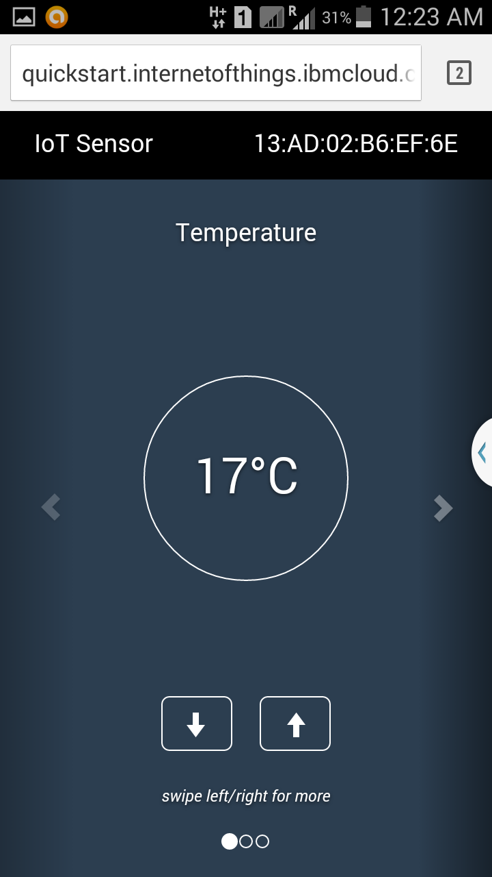
Using NodeRed and IBM Bluemix
http://iotsimulation.mybluemix.net/red/#
http://quickstart.internetofthings.ibmcloud.com/iotsensor

Slide 11
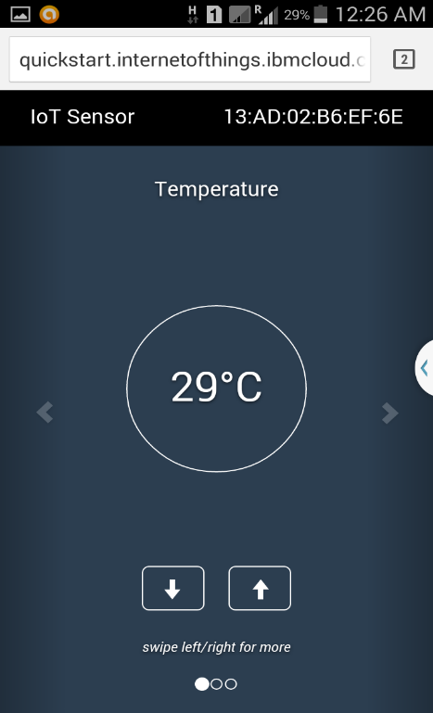
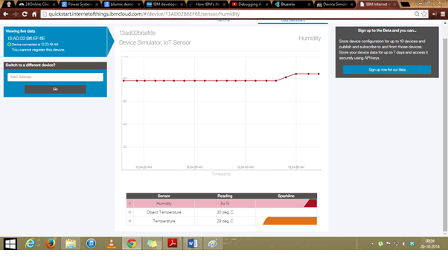
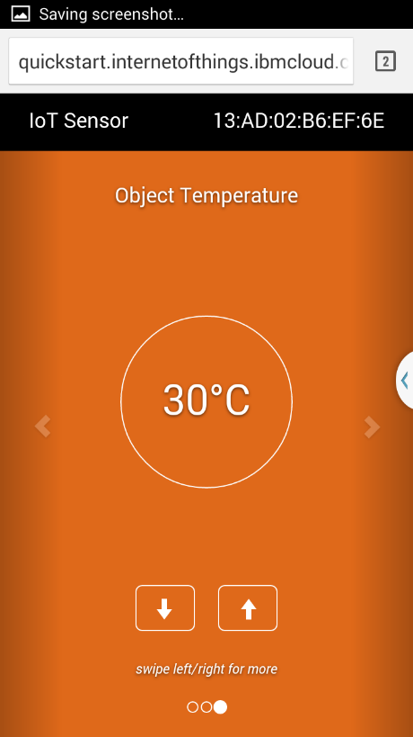
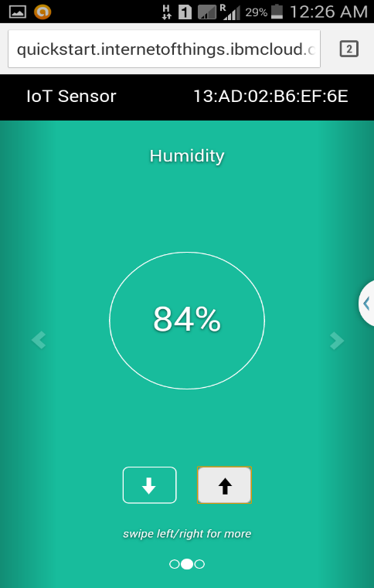

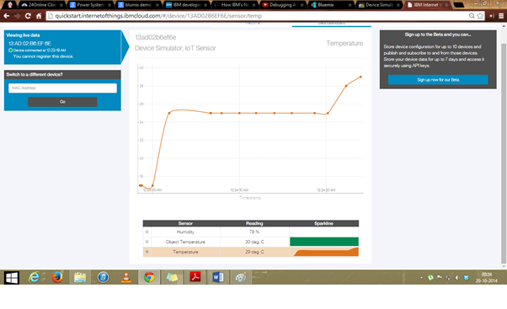

Slide 12
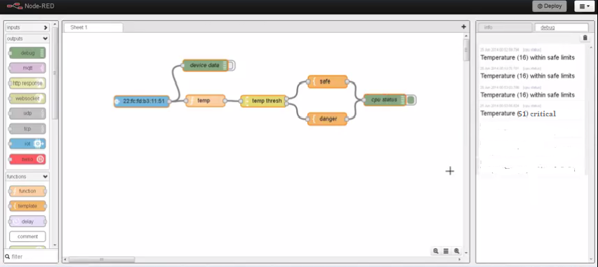

Slide 13
[{"id":"588f19a5.a1db88","type":"iot","name":"IoT
device","deviceId":"","messageType":"*","x":103,"y":195,"z":"11ea8b41.55b0cd","wires":[["c5767134.51056"]]},{"id":"c5767134.51056","type":"function","name":"Extract temperature","func":"var data ={};\n\nif (!context.global.hasOwnProperty(\"device\")) {\n\tcontext.global.device = \"\";\n}\n\nvar events= msg.payload.d;\nvar temperature = 0;\n\n// Raspberry Pi events have \"myPi\" name, \n// so extract
cputemp \nif(events.myName == \"myPi\") {\n\tcontext.global.device = \"Raspberry Pi\";\n\ttemperature= events.cputemp;\n} else {\n// IoT simulator sensor events\n// so extract temp\n\tcontext.global.device
= \"IoT sensor\";\n\ttemperature = events.temp;\n}\n\ndata.cputemp = temperature;\n\nmsg.payload =
temperature;\n\nreturnmsg;","outputs":1,"x":293,"y":196,"z":"11ea8b41.55b0cd","wires":[["dec22b67.b2ea38"]]},{"id":"dec22b6
7.b2ea38","type":"switch","name":"Switch high and low
temp","property":"payload","rules":[{"t":"gt","v":"50"},{"t":"lt","v":"10"}],"checkall":"true","outputs":2,"x ":552,"y":196,"z":"11ea8b41.55b0cd","wires":[["975d7125.34bdc8"],["727dfdf1.29cfcc"]]},{"id":"975d712
5.34bdc8","type":"function","name":"High Temp","func":"var temperature = msg.payload;\n\nvar twitMessage = \"HIGH temperature Alert @ \"+context.global.device+\"!! The temperature is \"+temperature+\" deg C at \"+new Date();\n\nreturn {topic: \"\", payload: twitMessage};","outputs":1,"x":773,"y":111,"z":"11ea8b41.55b0cd","wires":[["824d6856.5bc698"]]},{"id":"727dfdf1.29cfcc","type":"function","name":"Low Temp","func":"var temperature = msg.payload;\n\nvar twitMessage = \"LOW temperature Alert @ \"+context.global.device+\"!! The temperature is \"+temperature+\" deg C at \"+new Date();\n\nreturn {topic: \"\", payload:
twitMessage};","outputs":1,"x":772,"y":278,"z":"11ea8b41.55b0cd","wires":[["824d6856.5bc698"]]},{"id": "824d6856.5bc698","type":"twitter out","twitter":"","name":"Tweet temperature alerts","x":978,"y":189,"z":"11ea8b41.55b0cd","wires":[]}]

Slide 14
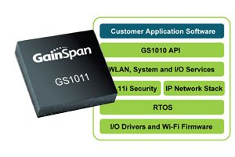
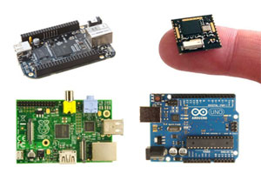
Hardware
Wireless SOC(System on chip) manufactures like Gainspan , Wiznet , Nordic Semiconductor , TI and others are creating self-contained, RF-certified module solutions that have TCP, UDP and IP on chip.
These solutions include built-in security features, can reduce certification times and allow companies to add communication to any microcontroller-based (MCU-based) product with little RF expertise.
Prototyping boards and platforms From the Arduino to the Raspberry Pi to the new BeagleBone Black , there are a large number of community DIY and prototyping platforms available that are making its possible to create your own Internet of Things project

Slide 15
Cloud Platform and Machine Learning
Intel
IBM
Microsoft
Schneider
Cisco
GE labs
Sap Labs

Slide 16
Architecture
The layered architecture has two distinct divisions with an Internet layer in between to serve the purpose of a common media for communication. The two layers at the bottom con-tribute to data capturing while the two layers at the top are responsible for data utilization in applications
Edge layer: this hardware layer consists of sensor networks, embedded systems, RFID tags and readers or other soft sensors in different forms. These entities are
the primary data sensors deployed in the field. Many of these hardware elements provide identification and information storage (e.g. RFID tags), information collection (e.g. sensor networks), information processing (e.g. embedded edge processors), communication, control and actuation.

Slide 17
Access gateway layer: the first stage of data handling happens at this layer. It takes care of message routing, publishing and subscribing and also performs cross platform communication, if required.
Middleware layer: this is one of the most critical layers that operates in bidirectional mode. It acts as an interface between the hardware layer at the bottom and the application layer at the top. It is responsible for critical functions such as device management and information management and also takes care of issues like data filtering, data aggregation, semantic analysis, access control, information discovery such as EPC (Electronic Product Code) information service and ONS(Object Naming Service)
Application layer: this layer at the top of the stack is responsible for delivery of various applications to different users in IoT. The applications can be from different industry verticals such as: manufacturing, logistics, retail, environment, public safety, healthcare, food and drug etc. With the increasing maturity of RFID technology, numerous applications are evolving which will be under the umbrella of IoT.

Slide 18
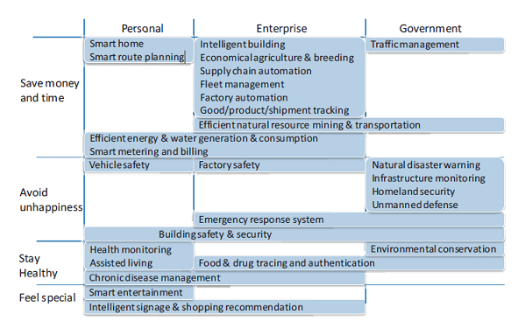
Applications

Slide 19
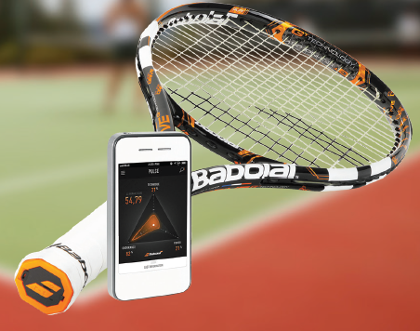
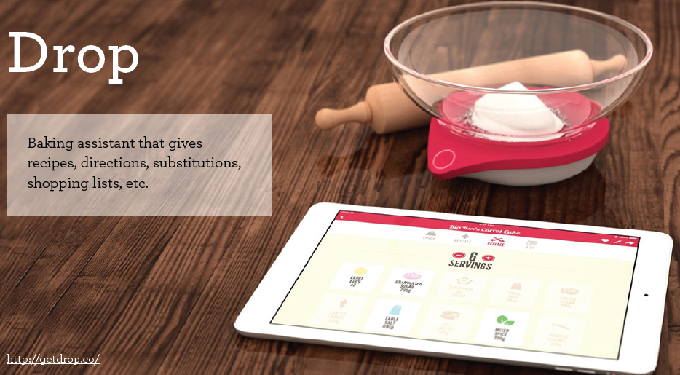
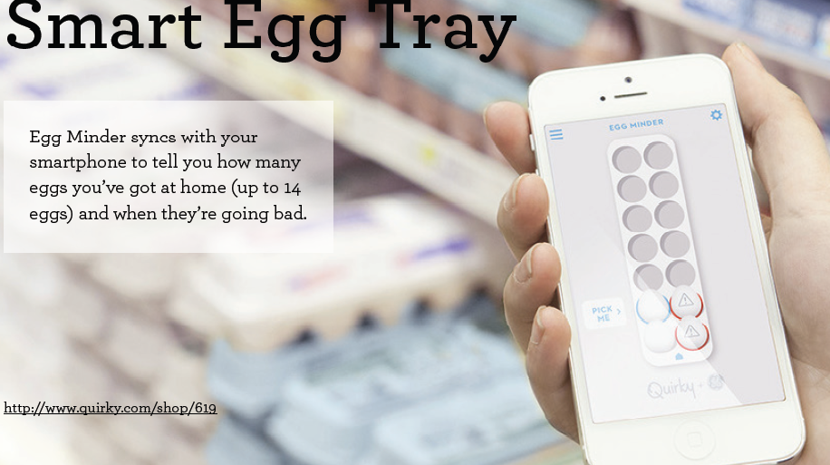

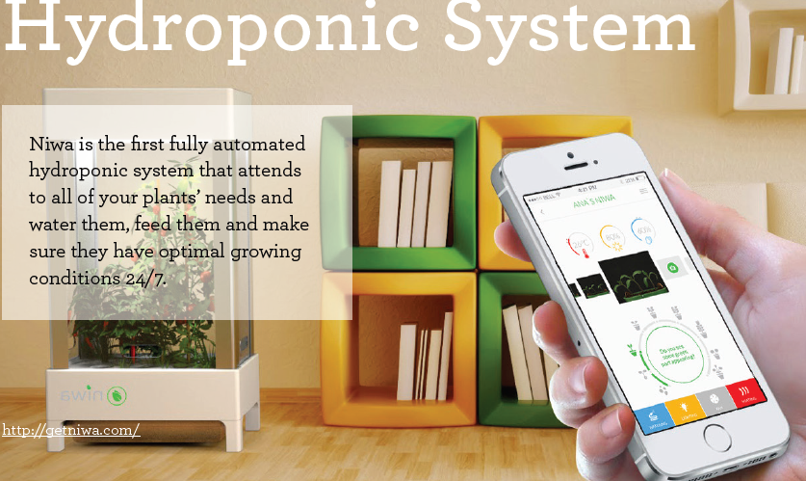

Slide 20
Smart Home/Buildings
Smart Cities
Smart Grids
Environmental monitoring
Healthcare
Smart Business/inventory and Product management
Security and Surveillance

Slide 21
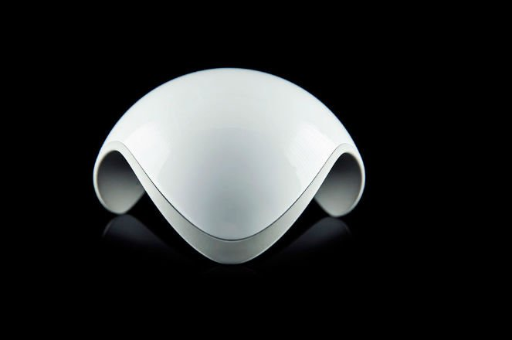
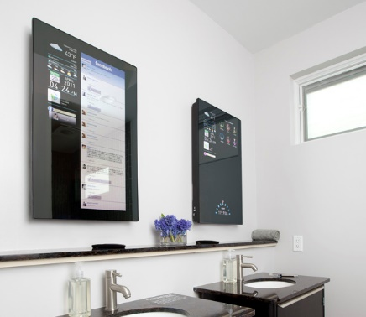
Smart Building /Home
Reducing the consumption of resources associated to buildings (electricity, water)
Both in economic terms (reduced operational expenditures) as well as societal ones (reducing the carbon footprint associated to buildings, which are a key contributors to the global greenhouse gas emissions
as well as in improving the satisfaction level of humans populating it.eg: optimum temperature using smart Hvac system
Cybertecture mirror
Notes:
Ninja sphere monitors temp,lighting your pet,fireplace ,washing machine or anything you conect to your sphere

Slide 22
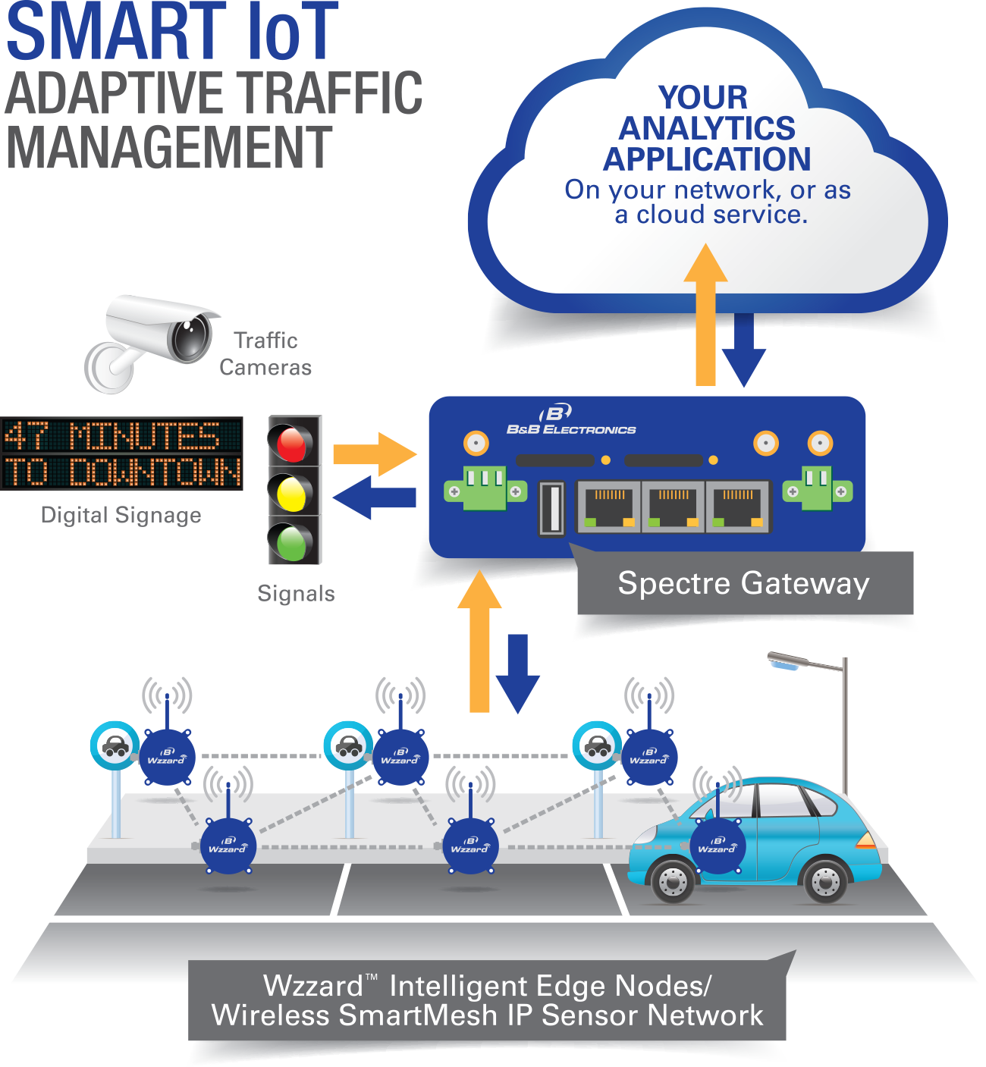
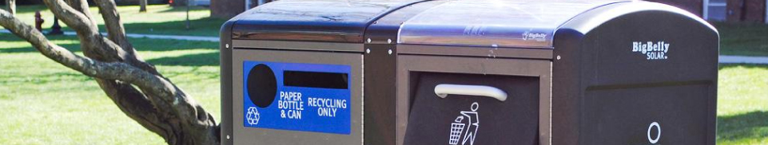
Smart Cities
Smart Parking Monitoring of parking spaces availability in the city.
Structural health Monitoring of vibrations and material conditions in buildings, bridges and historical monuments.
Noise Urban Maps Sound monitoring in bar areas and centric zones in real time.
Traffic Congestion Monitoring of vehicles and pedestrian levels to optimize driving and walking routes.eg: placemeter
Smart Lighting Intelligent and weather adaptive lighting in street lights.
Waste Management Detection of rubbish levels in containers to optimize the trash collection routes.
Smart Roads Intelligent Highways with warning messages and diversions according to climate conditions and unexpected events like accidents or traffic jams.

Slide 23
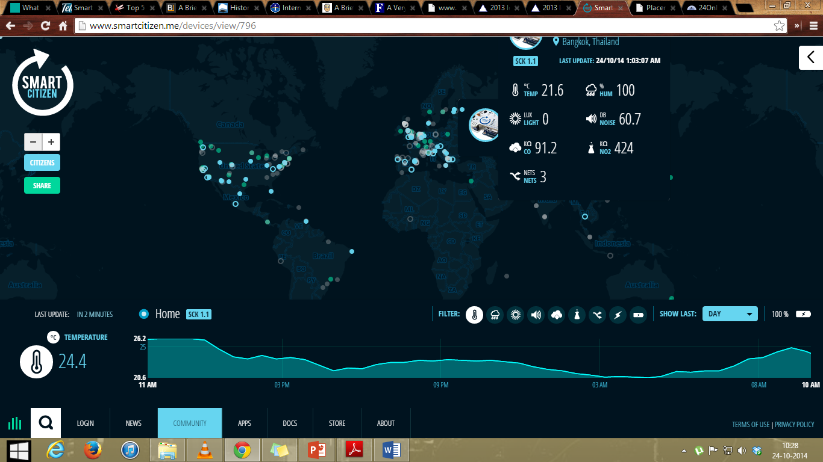
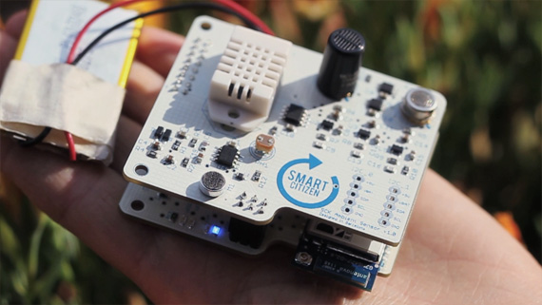

Slide 24
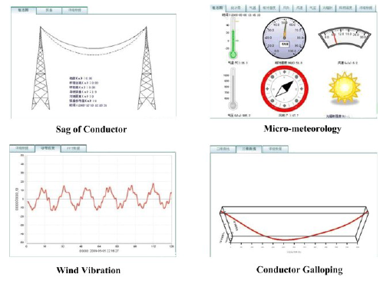
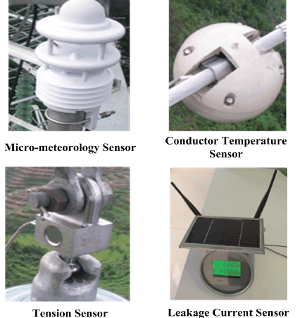
Smart Grid
Power Internet of Things (PIoT) can be widely applied in every aspect of smart grid, such as power generation, transmission, distribution and consumption. AMR (auto meter reading) gives real time data.
IoT based online monitoring system of power lines for transmission tower leaning, conductor galloping, icing, temperature, wind deviation, micro meteorology and EV assistant management systems are some of the areas.

Slide 25
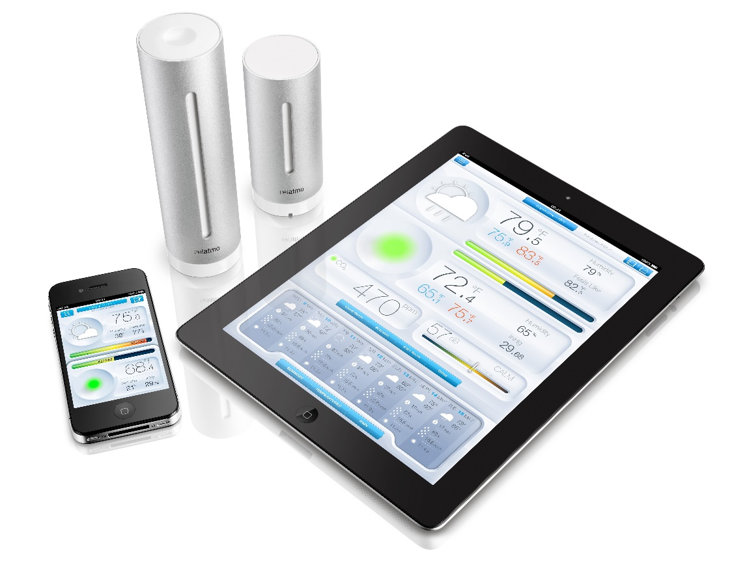
Environmental monitoring
natural phenomena and processes (e.g., temperature, wind, rainfall, humidity, noise etc) can be monitored and such heterogeneous data can be seamlessly integrated into global applications.
The vast deployment of miniaturized devices may enable access to critical areas, whereby the presence of human operators might not represent a viable option (e.g., volcanic areas, oceanic abysses, remote areas), from where sensed information can be communicated to a decision point in order to detect anomalous conditions
Netamo weather sensor
Notes:
Temp,hiumidity pollutants,noise

Slide 26
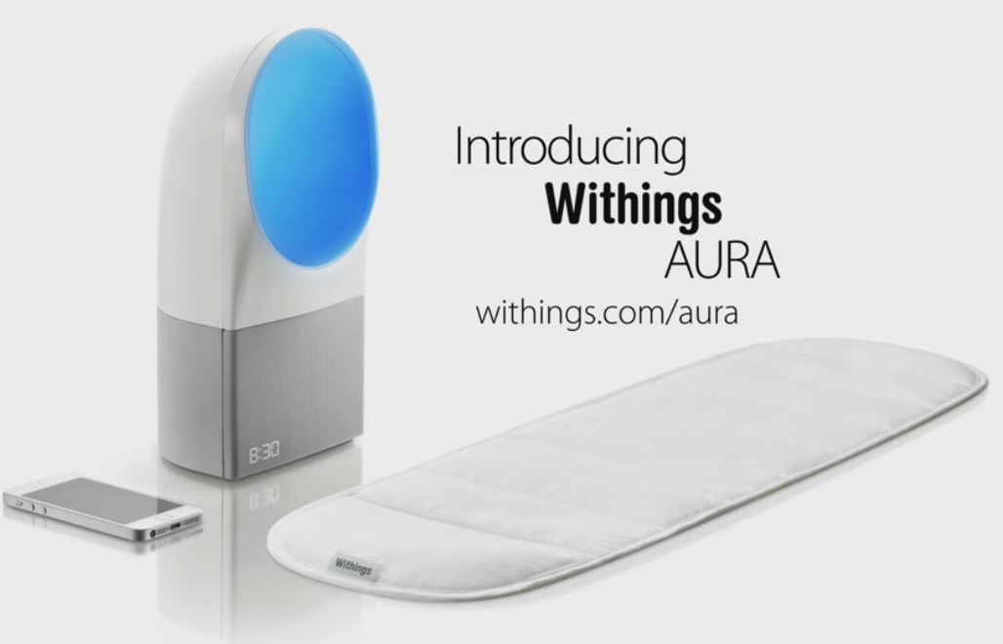
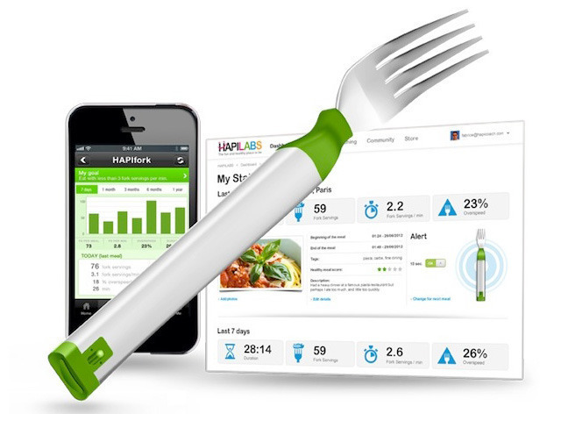
Healthcare
Sensors either wearable (e.g., accelerometers, gyroscopes) or fixed (proximity) will be used to gather data used to monitor patient activities in their living environments
The use of wearable sensors, together with suitable applications running on personal computing devices enables people to track their daily activities (steps walked, calories burned exercises performed, etc.), providing suggestions for enhancing their lifestyle and prevent the onset of health problems
Emergency situations
Notes:
hapifork

Slide 27
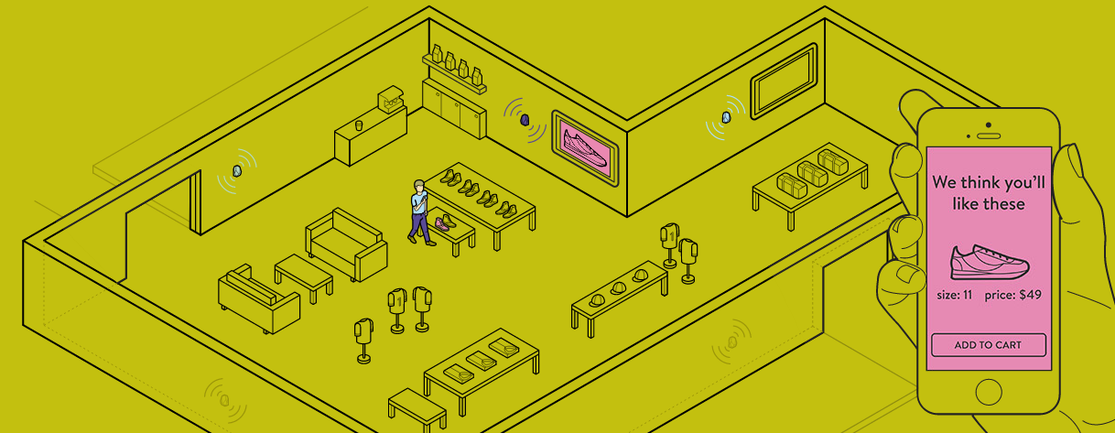
Smart Business/inventory and
Product management
RFID are customarily used to monitor and manage the movement of products through a supply chain, while readers are placed throughout the facility to be monitored. IoT technologies can provide enhanced flexibility in terms of readers positions, while at the same time enabling seamless interoperability between RFID-based applications
real-time product availability and maintain accurate stock inventory.
after-market support, whereby users can automatically retrieve all data about the products they bought.
Also, identification technologies can help in limiting thefts and in fighting counterfeiting by providing products with a unique identifier
bio-sensor technologies in combination with RFID technology final product quality and possible shelf life deterioration of the product, e.g., in the food industry parameters such as temperature and bacterial composition in order to guarantee required quality of the final product.

Slide 28
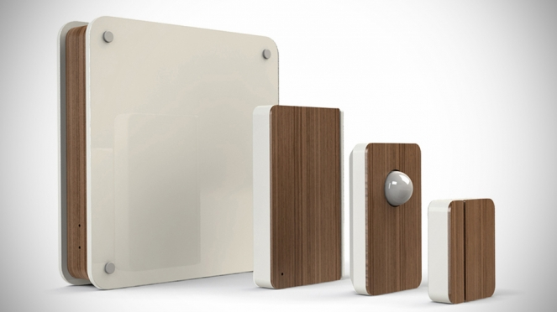
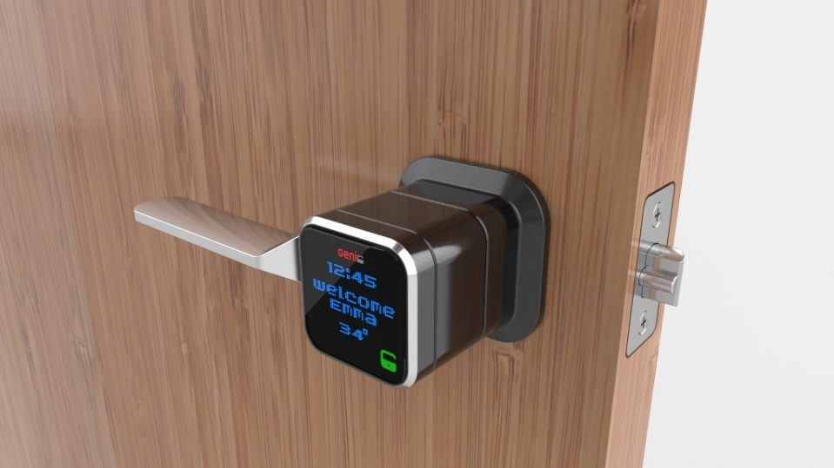
Security and Surveillance
Ambient sensors can be used to monitor the presence of dangerous chemicals.
Sensors monitoring the behaviour of people may be used to assess the presence of people acting in a suspicious way.
Personal identification by means of RFID or similar technologies is also an option.
Fire safety
Access control
Notes:
Scout alarm t sense if someone has been your backyard or home while you were away

Slide 29
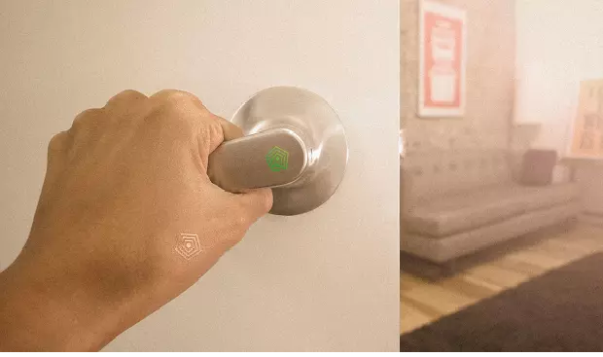
Challenges &Future Trends
Network Foundation—limitations of the current Internet architecture in terms of mobility, availability, manageability and scalability
Security, Privacy and Trust
Managing heterogeneity—managing and standardization of heterogeneous applications, environments and devices constitute a major challenge.
Managing and Mining large amount of information and data
Design of transducers to match small energy sources like irregular vibrations.

Slide 30
References
[1] ITU Internet report, 2005
[2] Lu Tang, Neng Wang, “Future Internet: The Internet of Things”, 2010 3rd International Conference on Advanced Computer Theory and Engineering (ICACTE)
[3] Yen-Kuang Chen, “Challenges and Opportunities of Internet of Things”,2012 IEEE
[4] Daniele Miorandi , Sabrina Sicari ,Francesco De Pellegrini ,Imrich Chlamtac,”Internet of things: Vision, applications and research challenges”
[5] Yang Song, Bingjun Han, Xin Zhang, Dacheng Yang,” Modelling and Simulation of Smart Home Scenario Based On Internet Of Things”
[6]Goldman Sachs, IoT Primer, “The Internet of Things: Making sense of the next mega Trend”, September 3,2014
[7]www.wikipedia.com
[8] Louis Coetzee, Johan Eksteens, ”The Internet of Things – Promise for the
Future? An Introduction”, IST-Africa 2011 Conference Proceedings
[9] http://postscapes.com/internet-of-things-technologies
[10] Iker Mayordomo, Peter Spies, Fritz Meier, Stephan Otto, Sebastian Lempert, Josef Bernhard and Alexander Pflaum ”Emerging technologies and challenges for internet of things”
[11] Qinghai Ou, Yan Zhen, Xiangzhen Li, Yiying Zhang, Lingkang Zeng “Application of IoT in smart grid power transmission”,2012

Slide 31
Thank you
Questions??

